Slide 1



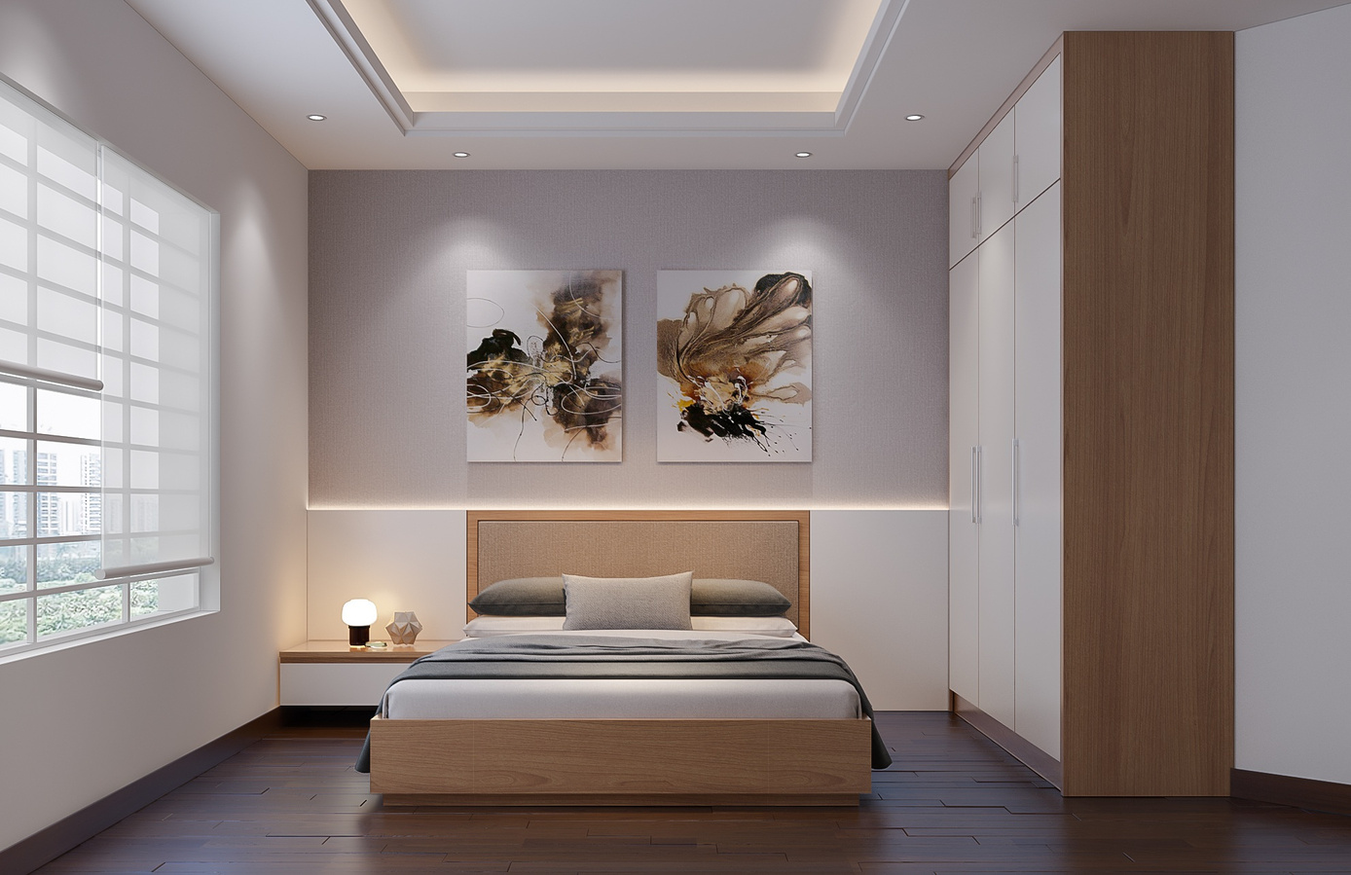



ModifAI
Project Update 6
Overview of progress and future plans for our AI-powered interior decor app

Slide 2






Team Introduction for ModifAI Project Update 6
Akram Hossain Apu Khan – 2231090642
Mehedi Hasan Dip – 2232167042
Together, we are transforming interior decor through AI technology.
Hacibull Hashan Tosher – 2111626642

Slide 3




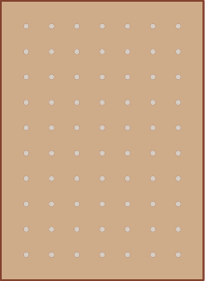
Key Concepts Behind ModifAI's Innovation in Interior Decor
AI-driven design enhances creativity and personalization for users.
Efficient algorithms streamline decor suggestions tailored to individual preferences.
User-friendly interface ensures ease of navigation and interaction.
Real-time communication fosters community engagement among users.

Slide 4



This Week's Progress
In Update 6, our team has made significant strides. We have successfully fixed all previous errors that were affecting functionality. In addition, we developed a user-to-user chat system that allows users to communicate in real time. This enhancement is pivotal for user engagement, enabling seamless interactions. Our focus remains on creating a user-friendly experience as we continue to refine and enhance the ModifAI app. We are excited about these improvements and look forward to showcasing them in our upcoming demo.

Slide 5

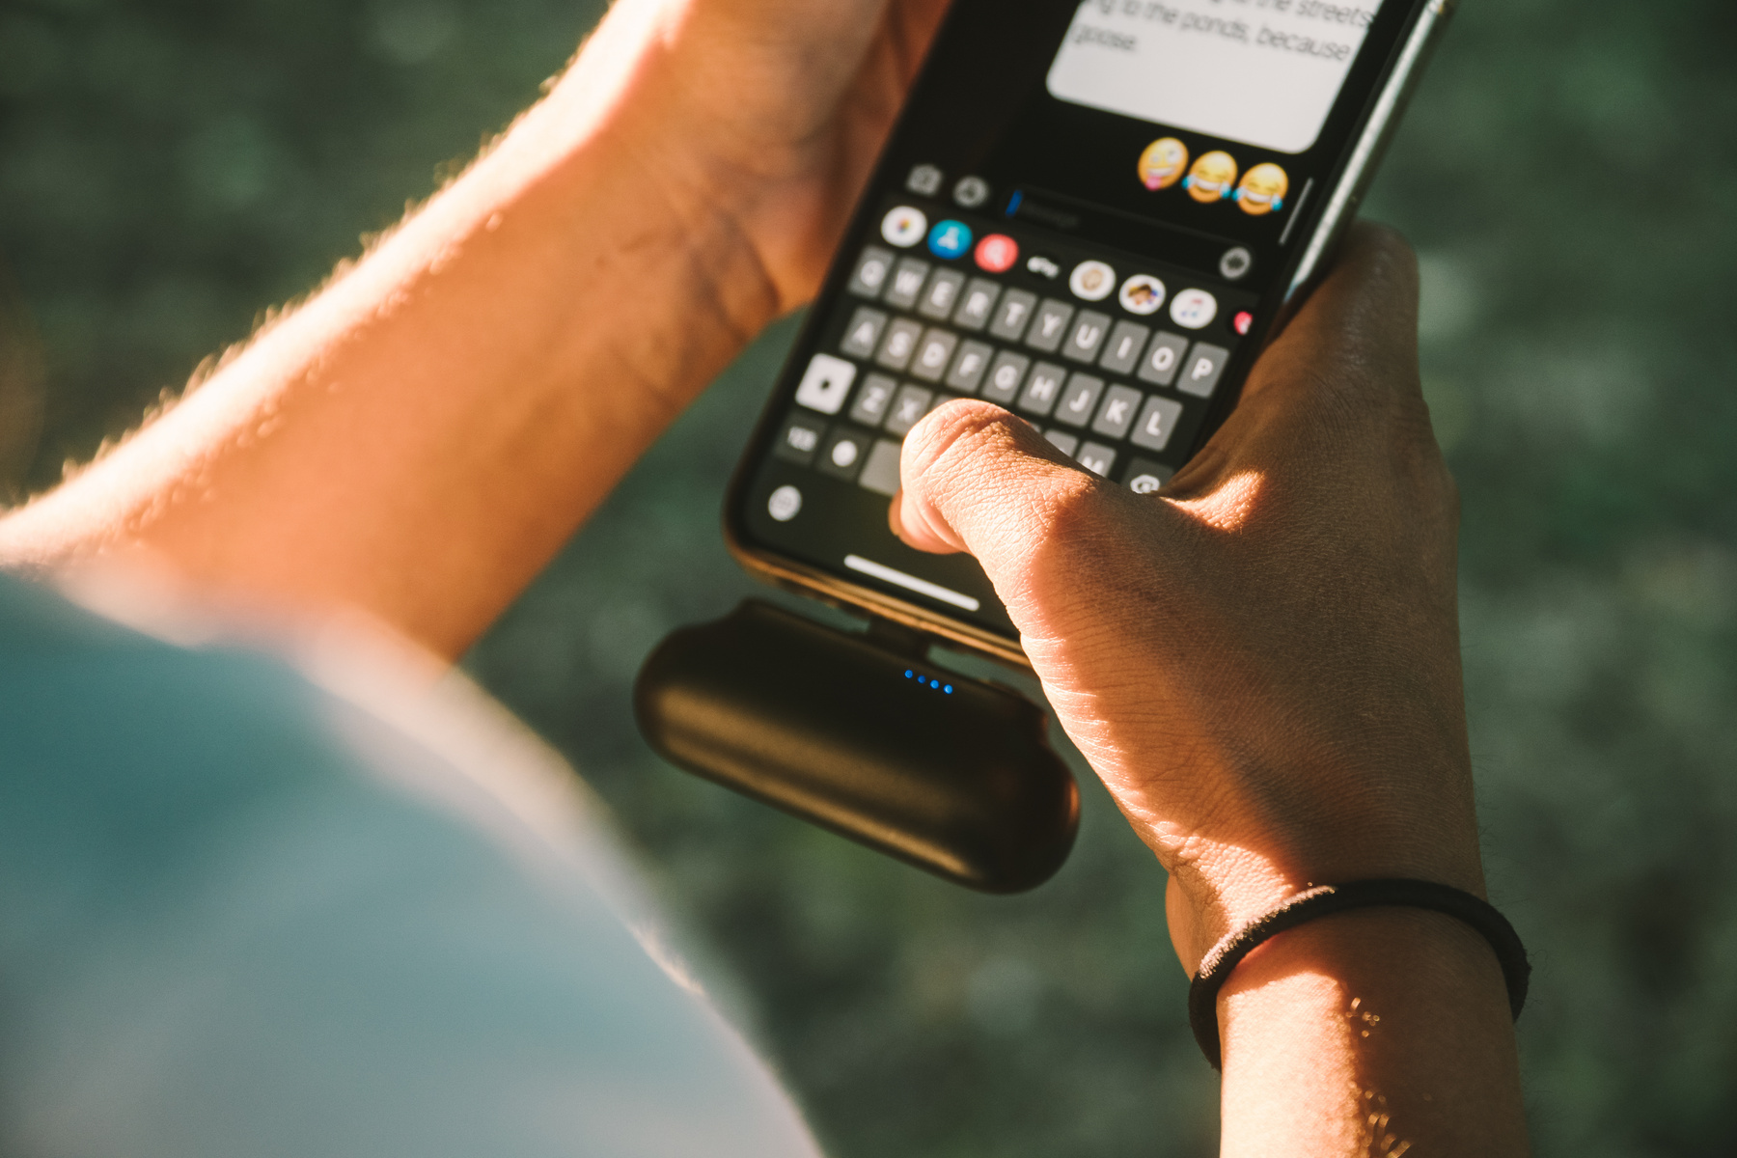
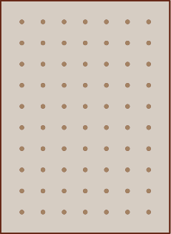
Enhancing Communication with Real-Time Messaging
ModifAI introduces a real-time messaging system that allows users to communicate seamlessly. This feature enhances user interaction, making it easier to share ideas and suggestions while decorating their spaces. The intuitive interface ensures that conversations are smooth and effective, elevating the overall user experience and fostering a collaborative environment.
Connect and collaborate effortlessly with ModifAI's messaging system.

Slide 6
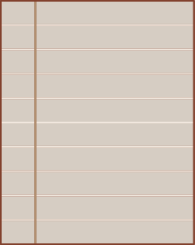




Our Next Steps: Exciting Features and Enhancements Ahead
Add a group chat feature for enhanced communication among users.
Implement image sharing to enrich user interactions in chats.
Improve AI algorithms to provide smart decor recommendations.
Refine user interface for a more seamless experience overall.

Slide 7
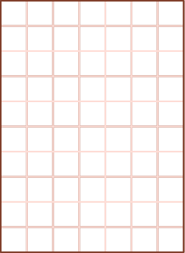


Conclusion and Future Work for ModifAI
As ModifAI evolves, we aim to enhance user experience by adding innovative features and improving AI capabilities for better interior decor solutions.
Enhanced Communication
Improved Features
Future AI Developments
Our focus will be on integrating image sharing, allowing users to send and receive decor inspirations instantly.
Implementing a group chat feature will allow users to collaborate effortlessly and share ideas with one another.
We strive to enhance our AI capabilities, ensuring personalized decor suggestions that cater to each user's unique style and needs.

